Slide 1
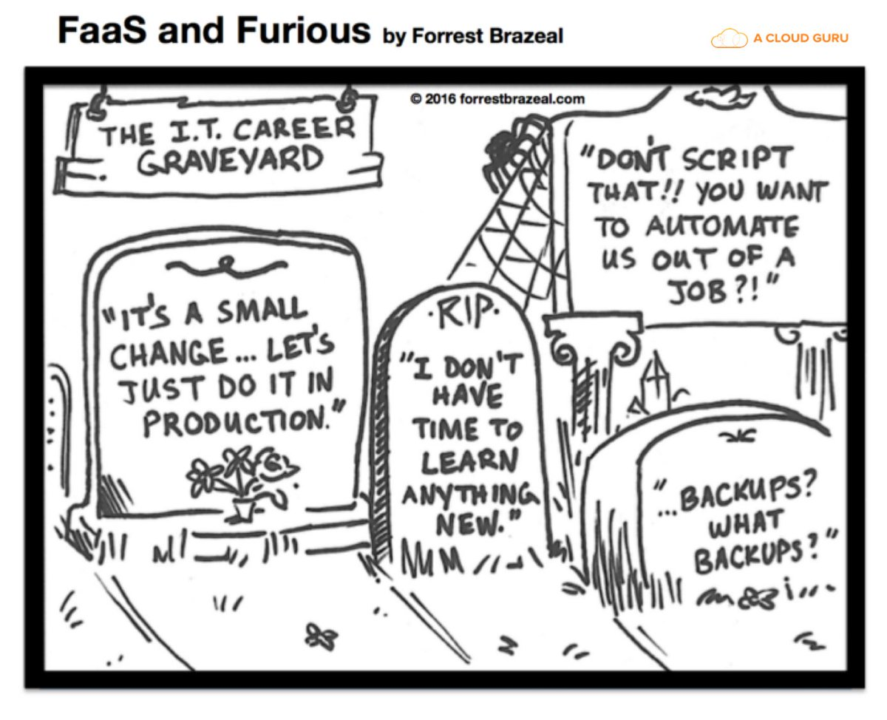
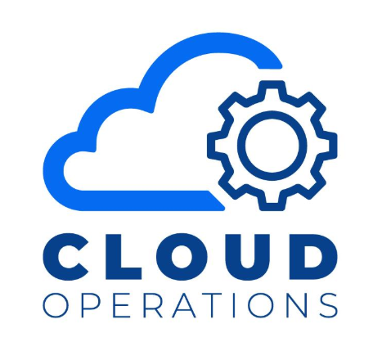
So You’ve got the Cloud: Now What?

Slide 2
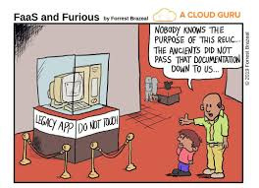
Objectifs / Objectives
Part 1 (April 2021)
ESDC Cloud Environment overview (Revisit)
Cloud Intake
Now What?
Azure DevOps
Part 2 (May 2021)
SCED
ATO
Supporting your solution

Slide 3
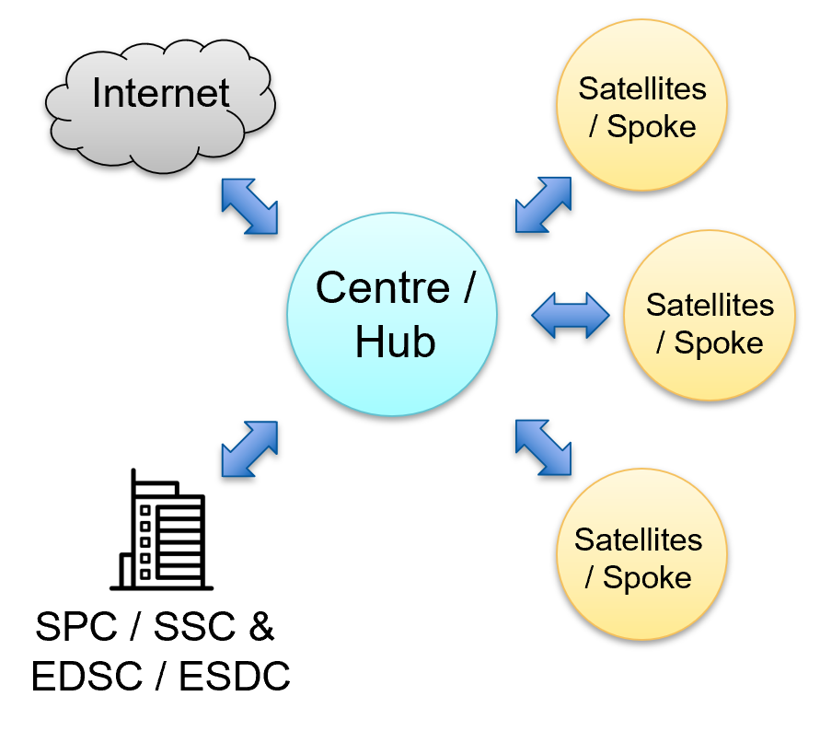
Cloud Environment: Hub and Spoke
Hub & Spoke
Hub (CloudOps and CyberOps) is responsible for enterprise tool administration and monitoring
Cloud Workspace provisioning
SCED and Perimeter Firewall administration,
Enterprise DNS and network services,
Enterprise security monitoring and policies
Azure Active Directory services
Spoke (Application development teams) is responsible for all aspects of the application design, build and hosting
Application development and testing
Hosting environments in the cloud (creation and administration)
Networking of application components (including network security configuration)
Administration of Azure DevOps Project/ALM Tools

Slide 4
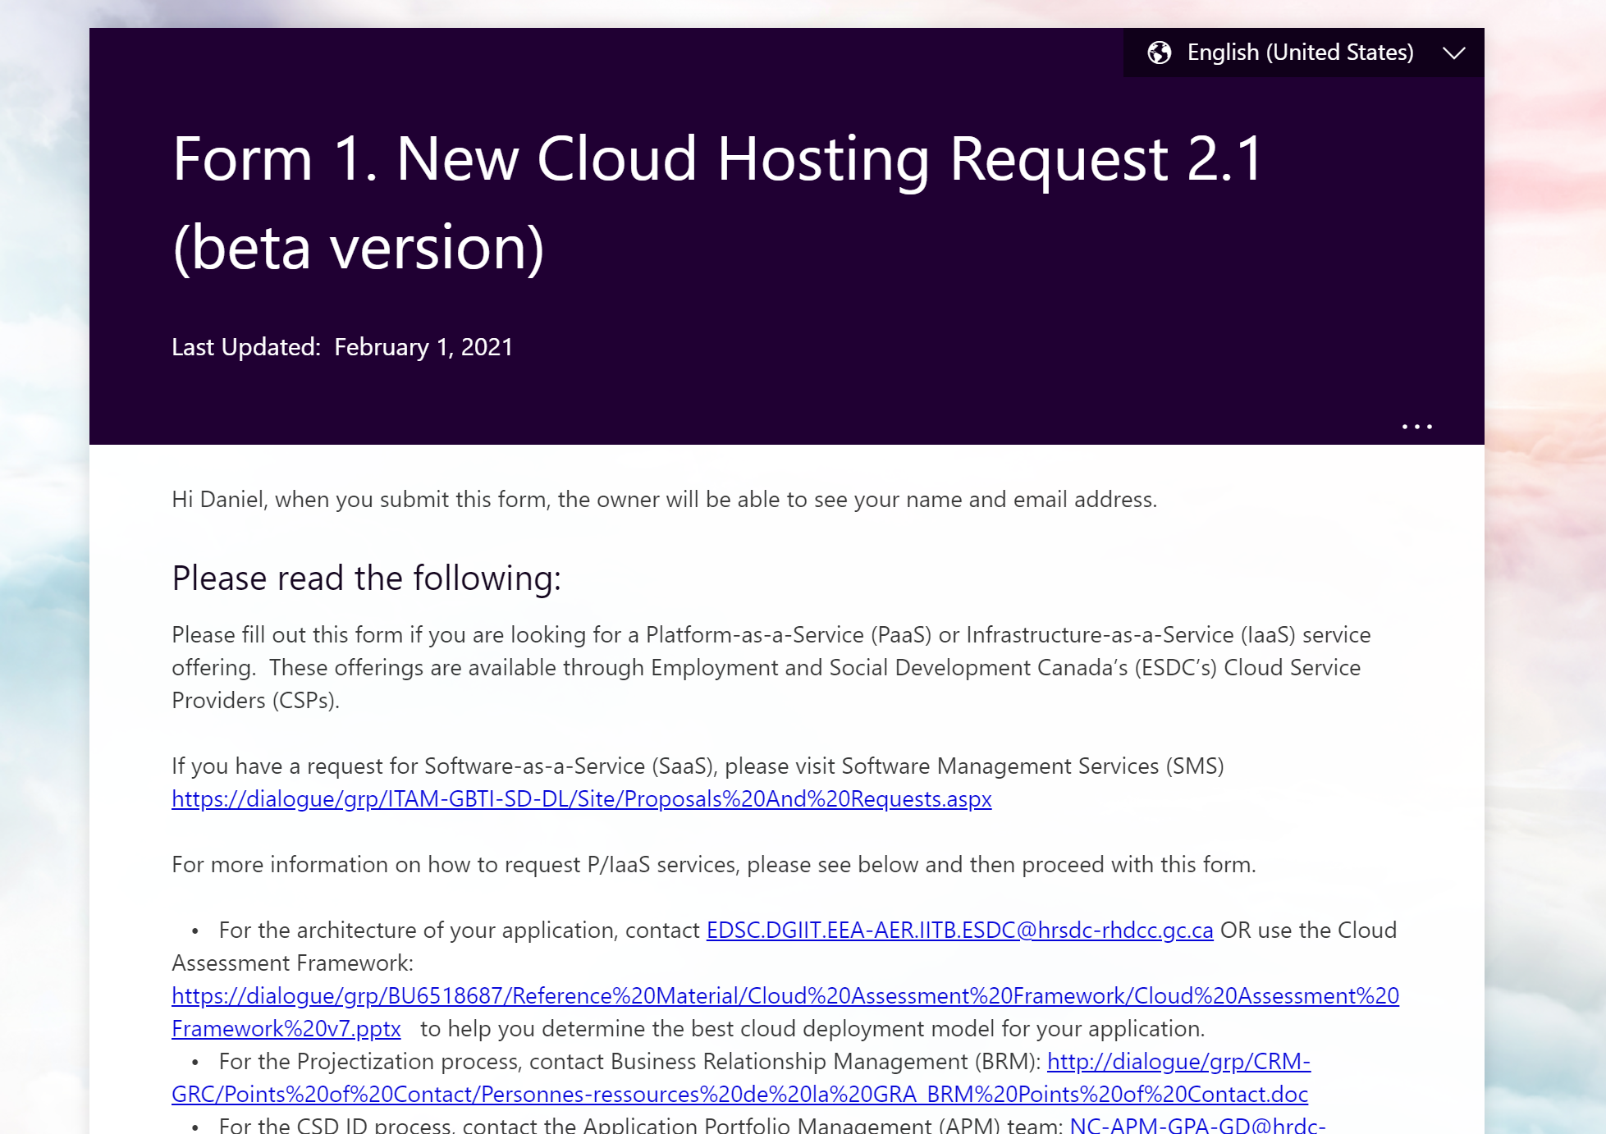
Cloud Intake: What you’ll need to get cloud
Cloud Hosting Request form
Purpose of the Cloud Request form
How it works
Which environment should you start with?
What are Sandbox, Dev, Prod?
Three typed of environments: Sandbox, Development and Production
Sandbox is used to become familiar with the platform and to bolster self-guided training
There is no connectivity back to on-prem resources and the active directory in Sandbox
Sandbox costs are covered by the department (up to 3 months or $5000)
Development implements guardrails and is meant to mirror production
Connectivity to the AAD an on-prem is available
Costs are tracked and charged back to the team
Production is where your final deployment resides
Keep in mind that you are responsible for maintaining your production environments
Production subscription is not live in production
Applications aren’t “live” until they have undergone release standards testing and have attained ATO

Slide 5
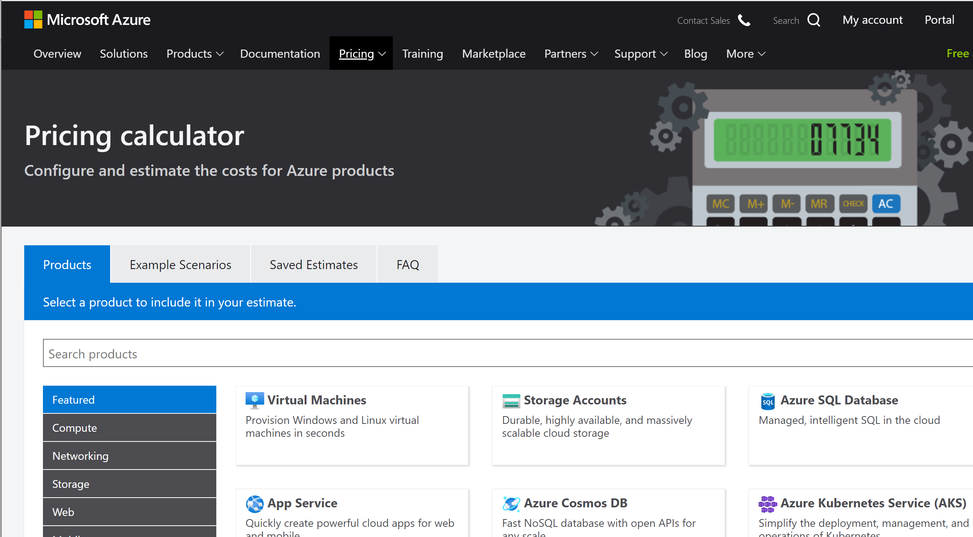
Cloud Intake: What you’ll need to get cloud
What is required for Dev/Prod
Source of funding
CSDID Number
Preliminary design
Cost estimate
How to estimate your costs
Azure cost calculator
Additional considerations
Charge back/show back
How does it work?
Who is in charge of monitoring/tracking costs

Slide 6




Cloud Environment: How does it work?
You want a puppy?

Slide 7
Cloud Environment: How does it work?
You want a puppy?
Take care of your puppy…

Slide 8
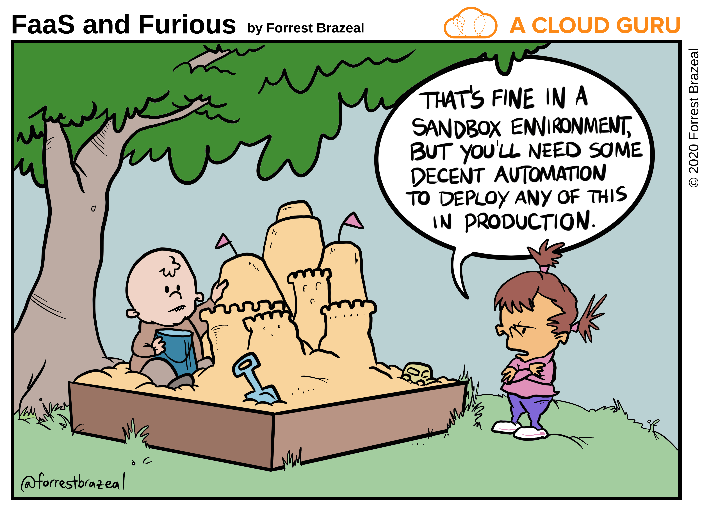
So You’ve Got Cloud… Now What?
The cloud is more than just an easy way to get servers. Explore some of the options available to you
Use your time in the sandbox to experiment with technology you’ve never used before
Take the time to learn how these technologies work – you’re going to be responsible for them in dev/prod
Find resources online to help enable you to learn more
Ask questions
Don’t be afraid to think outside of the box
While there are “recommended toolsets” in the cloud, that doesn’t mean you can’t experiment and implement new technologies
New platforms are being released daily in the cloud. Try them out. There’s no commitment.
If you encounter failure in your initial plan, don’t be afraid to change course – in fact, you should plan on failing. It’s the best way to learn.
Start using Cloud/DevOps methodologies
Infrastructure as code
CI/CD
Automated testing
Policies and guardrails
If you don’t know them, learn them. Don’t be afraid to ask for guidance.

Slide 9
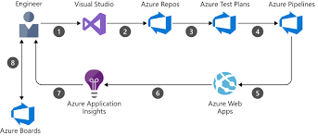
Azure DevOps Service
Why Azure DevOps Service?
Roles and Responsibilities
ADO Service is not managed centrally.
Your team is responsible for the creation and administration
SaaS offers hosting of a code repositories, work items, test plans, build and release pipelines, access to plugins, integration with M365 products, etc…
Currently no connection to On-Prem ADO
Connect it to your ESDC Cloud Environment
Connection to your Azure workspace is done using a Service Principal
ADO should be used to manage your application code as well as Infrastructure as Code templates
Build and release agents can either be “Microsoft hosted” (on demand) or “self-hosted” (hosted in your workspace)
Licensing/Access
Leverage our current Visual Studio Enterprise License
5 free “guest” users per organization
Additional costs?

Slide 10
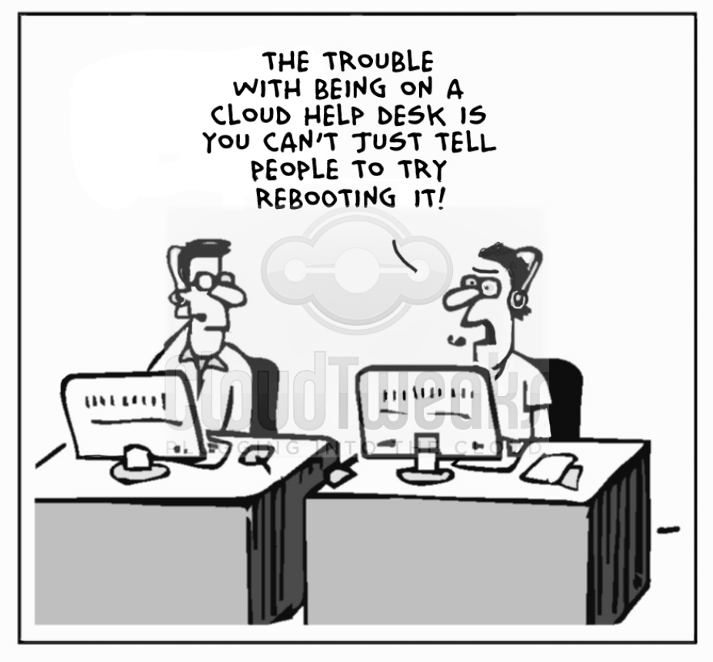
Links/contacts
Cloud intake forms (CCoE Sharepoint): https://dialogue/grp/BU6518687/SitePages/Request%20Cloud.aspx
Cloud Operations GD Box: EDSC.SOUTIEN.DOPS.INFONUAGIQUES-CLOUD.OPS.SUPPORT.ESDC@hrsdc-rhdcc.gc.ca
Cloud Operations SharePoint: https://014gc.sharepoint.com/sites/OI-CO/
Azure Portal: https://portal.azure.com
Azure DevOps: https://dev.azure.com

Slide 11
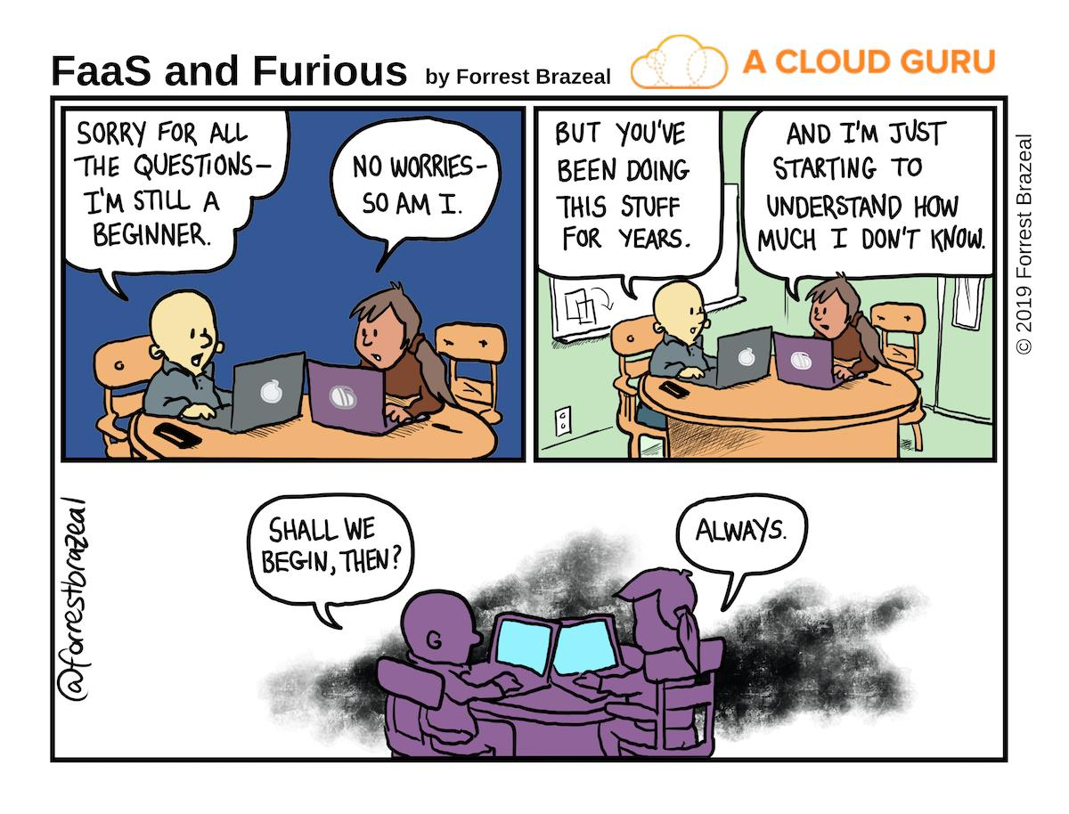


Avez-vous des questions ? / Do you have any questions?

